Slide 1
Solve CSPs using Backtracking Search

Slide 2
















Motivation
Easy Sudokus can be solved by inference over constraints (constraints propagation).
How about the hard ones?
We could apply depth-first search:
Note:
➔ Backtracking search

Slide 3
















Ideas of Backtracking search
A depth first search that chooses values for one variable at a time and backtracks when a variable has no legal values left to assign.
Main steps:

Slide 4
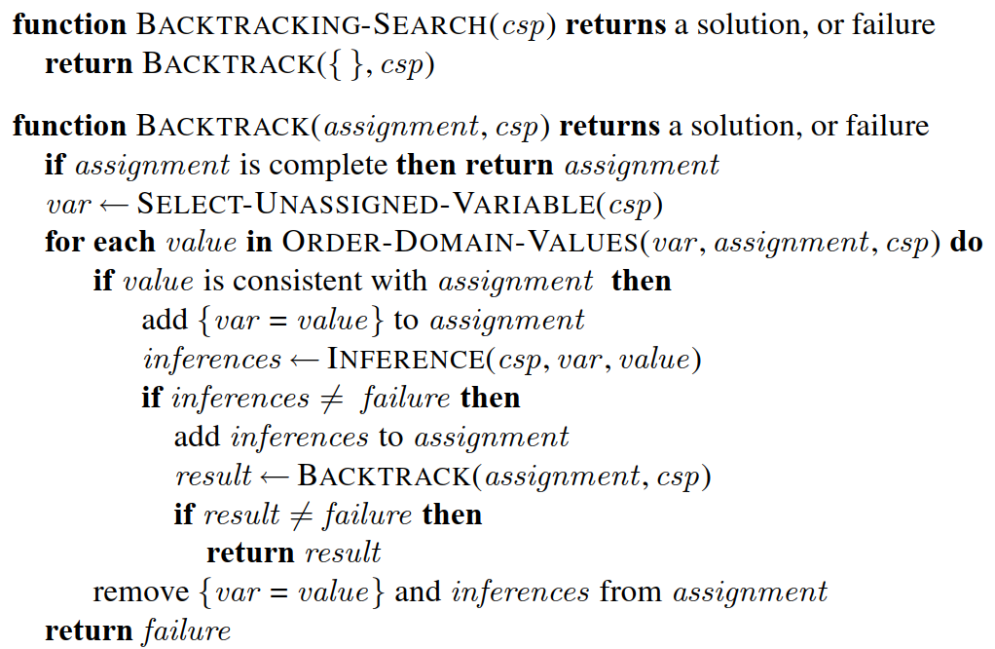









Backtracking search algorithm
Source: (Russell, 2016)

Slide 5
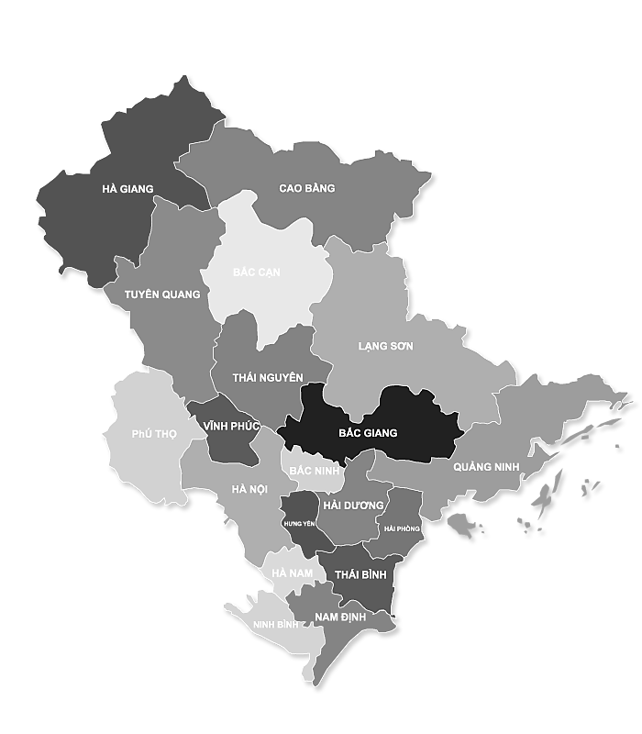



















Demo

Slide 6




Comments on backtracking search algorithm
Source: (Russell, 2016)

Slide 7




1. Select next variable and value
For the selection of next variable:
Random selection
Minimum remaining-values heuristic
Degree heuristic

Slide 8






1. Select next variable and value
For the selection of next value:
Random selection
Least-constraining-value heuristic

Slide 9














2. Inference
Propagation constraint to reduce domains of other variables when having a new assignment (var = value).
Forward checking: Forward checking doesn’t detect all inconsistencies, for example
Maintaining arc consistency:
 | PhuTho | VinhPhuc | BacNinh | BacGiang | HungYen
HaNoi = blue
HaiDuong =

Slide 10

















3. Backtracking strategies
Chronological backtracking:
Backjumping: store a conflict set – set of assignments conflicted with the value of current variable.

Slide 11
Solve CSPs using Local Search

Slide 12






















Local search for CSPs – Ideas
Idea:

Slide 13
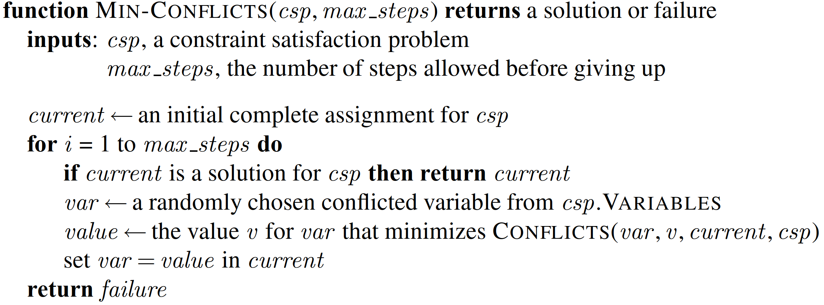
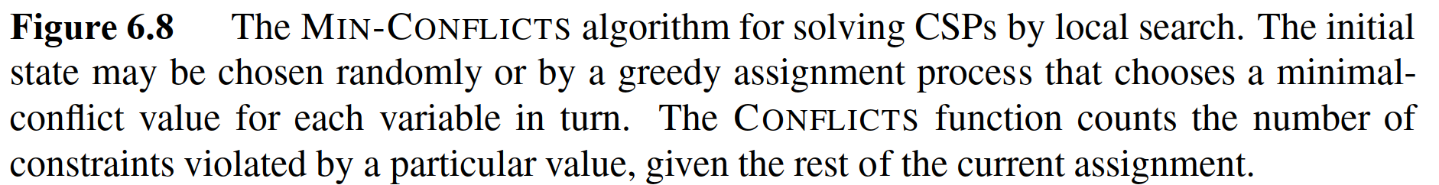






Min-conflict algorithm
Source: (Russell, 2016)

Slide 14
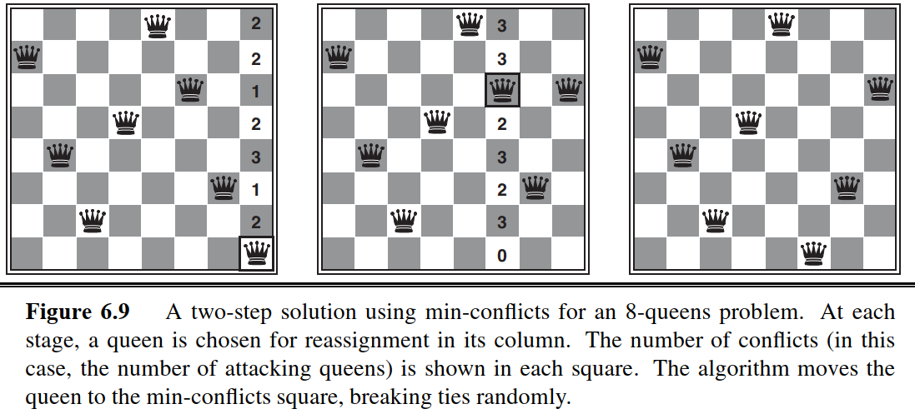






Demo
Source: (Russell, 2016)

Slide 15





Min-conﬂicts is surprisingly effective for many CSPs.
It solves even the million-queens problem in
It has been used to schedule observations for the Hubble Space Telescope, reducing the time taken to schedule a week of observations from
Photo: scitechdaily

